Slide 1
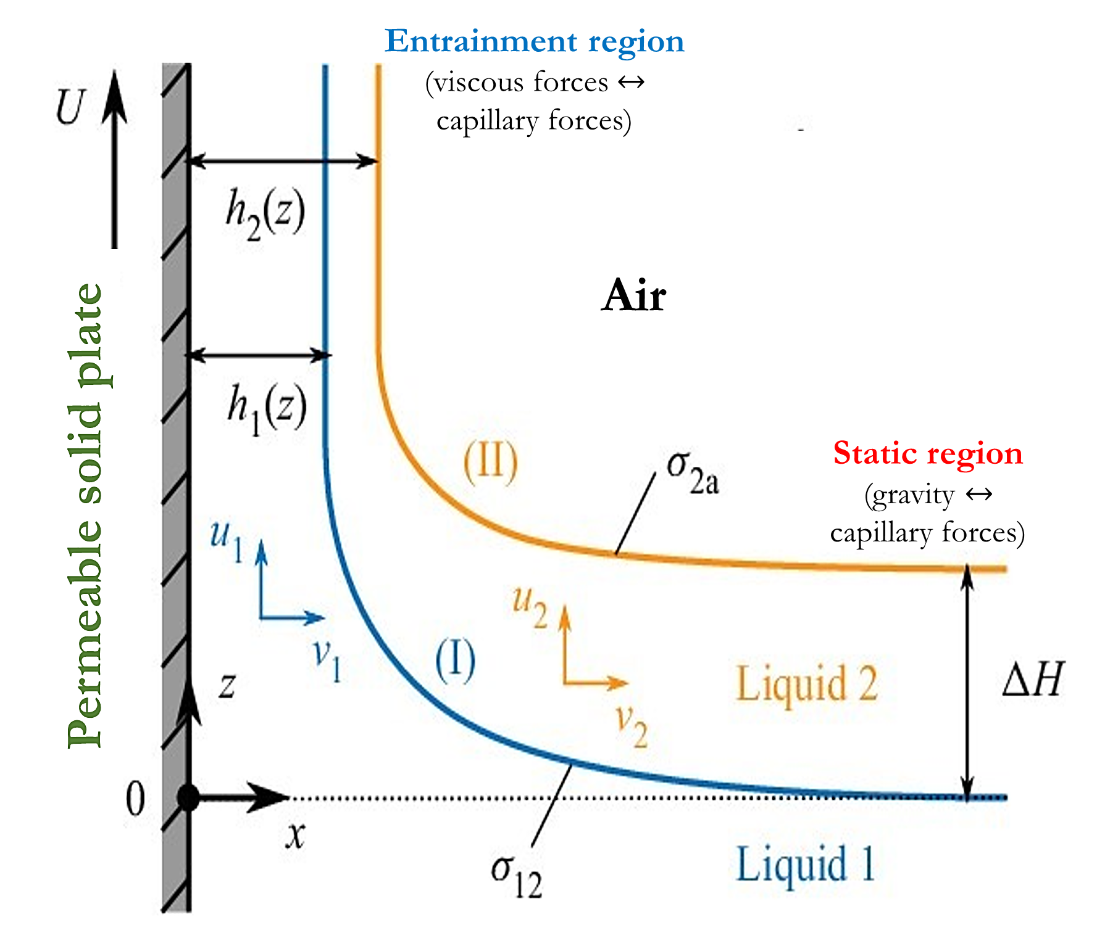
Title of the poster (not more than 15 words)
Presenting author¹, Second author¹, Third author²
¹Address 1
²Address 2
Problem formulation and methodology
Relevance 1
Relevance 2
Relevance 3
Relevance 4
Relevance 5
Relevance 6
Objective
The objective of the research work undertaken can be described here.
Results
Legacy
Landau-Levich
problem¹
(1942)
Dip coating of Newtonian liquid on a flat non-porous substrate.
Sathyanath
et al.²
(2020)
Dip coating of Newtonian liquid on a flat saturated porous substrate.
Champougny
et al.³
(2021)
Dip coating of two immiscible Newtonian liquids on a flat non-porous substrate.
Present work
In the low capillary number regime $\left(Ca≪1\right)$, and in the limit of negligible evaporation, the deposited film thickness varies as ${Ca}^{2/3}$
In the low capillary number regime (𝐶𝑎≪1), and in the limit of negligible evaporation, the deposited film thickness varies as 〖𝐶𝑎〗^(2/3)
Three distinct regimes of limiting thickness variation are possible depending on the operating parameter space.
Thickness of the inner film is always larger than the corresponding thickness for a one-liquid Landau-Levich flow.
Dip coating of two immiscible Newtonian liquids on a flat saturated porous substrate
Two-phase dip coating schematic
Dimensionless parameter | Name | Definition | Expression
$$\overline{Ca}$$ | Rescaled Capillary number | $$\frac{Viscous forces}{Capillary forces}$$ | $$\overline{Ca}=\frac{Ca}{ε^{3}}=\frac{μ_{1}U}{ε^{3}σ_{12}}$$
$$β$$ | Permeability factor | $$\frac{\begin{aligned}Permeability \\ coefficient\end{aligned}}{Capillary length}$$ | $$\frac{\sqrt{κ}}{\hat{α}εl_{c}}$$
Conclusions
References
Conclusion 1
Conclusion 2
Conclusion 3
Reference 1
Reference 2
Reference 3
Reference 4
Density ratio | Surface tension ratio | Viscosity ratio | Capillary length | Ratio of length scales (Porosity metric)
$R=$ $\frac{ρ_{2}}{ρ_{1}}$ | $$∑=\frac{σ_{2a}}{σ_{12}}$$ | $$M=\frac{μ_{2}}{μ_{1}}$$ | $$l_{c}=\sqrt{\frac{σ_{12}}{ρ_{1}g}}$$ | $$ε=\frac{x_{c}}{l_{c}}=\sqrt{\hat{α}}{\left(\frac{\sqrt{κ}}{l_{c}}\right)}^{1/5}$$

